Slide 1

SASSY WITH

Slide 2
What is Sass ?
Notes:
Css with superpowers : programmable, simple, easy to maintain
CSS on its own can be fun, but stylesheets are getting larger, more complex, and harder to maintain. This is where a preprocessor can help. Sass lets you use features that don't exist in CSS yet like variables, nesting, mixins, inheritance and other nifty goodies that make writing CSS fun again.
Once you start tinkering with Sass, it will take your preprocessed Sass file and save it out as a normal CSS file that you can use in your web site.

Slide 3
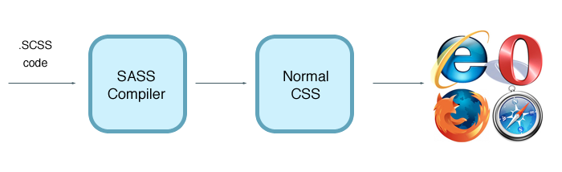
How its work ?
Notes:
CSS on its own can be fun, but stylesheets are getting larger, more complex, and harder to maintain. This is where a preprocessor can help. Sass lets you use features that don't exist in CSS yet like variables, nesting, mixins, inheritance and other nifty goodies that make writing CSS fun again.
Once you start tinkering with Sass, it will take your preprocessed Sass file and save it out as a normal CSS file that you can use in your web site.

Slide 4
Dancing with Sass

Slide 5
Installation
http://rubyinstaller.org/downloads/
or
https://rubygems.org/pages/download
Tutorial :
http://leveluptuts.com/tutorials/sass-tutorials/1-how-install-sass

Slide 6
Preprocessing

Slide 7
Preprocessing
CSS
Fun
Stylesheets are getting larger
More complex
Harder to maintain
Sass
Preprocessor
Variables
Nesting
Mixins
Inheritance
Notes:
CSS on its own can be fun, but stylesheets are getting larger, more complex, and harder to maintain. This is where a preprocessor can help. Sass lets you use features that don't exist in CSS yet like variables, nesting, mixins, inheritance and other nifty goodies that make writing CSS fun again.
Once you start tinkering with Sass, it will take your preprocessed Sass file and save it out as a normal CSS file that you can use in your web site.

Slide 8
Variables

Slide 9
Variables
Store many things like colors, font stacks, or any CSS value that you’ll want to reuse
Notes:
Think of variables as a way to store information that you want to reuse throughout your stylesheet. You can store things like colors, font stacks, or any CSS value you think you'll want to reuse. Sass uses the $ symbol to make something a variable. Here's an example:

Slide 10
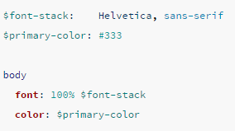
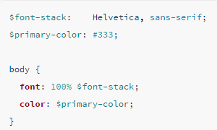
Variables
Sass SYNTAX
SCSS SYNTAX
Notes:
Think of variables as a way to store information that you want to reuse throughout your stylesheet. You can store things like colors, font stacks, or any CSS value you think you'll want to reuse. Sass uses the $ symbol to make something a variable. Here's an example:

Slide 11
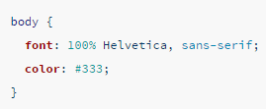
Variables
.CSS
Notes:
When the Sass is processed, it takes the variables we define for the $font-stack and $primary-color and outputs normal CSS with our variable values placed in the CSS. This can be extremely powerful when working with brand colors and keeping them consistent throughout the site.

Slide 12
Nesting

Slide 13
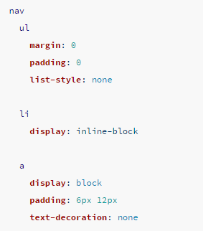
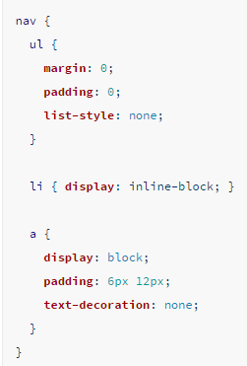
Nesting
Sass SYNTAX
SCSS SYNTAX
Notes:
When writing HTML you've probably noticed that it has a clear nested and visual hierarchy. CSS, on the other hand, doesn't.
Sass will let you nest your CSS selectors in a way that follows the same visual hierarchy of your HTML. Be aware that overly nested rules will result in over-qualified CSS that could prove hard to maintain and is generally considered bad practice.

Slide 14
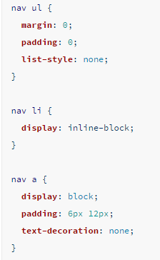
Nesting
.CSS
Notes:
You'll notice that the ul, li, and a selectors are nested inside the nav selector. This is a great way to organize your CSS and make it more readable. When you generate the CSS you'll get something like this:

Slide 15
Import
Notes:
CSS has an import option that lets you split your CSS into smaller, more maintainable portions. The only drawback is that each time you use @import in CSS it creates another HTTP request. Sass builds on top of the current CSS @import but instead of requiring an HTTP request, Sass will take the file that you want to import and combine it with the file you're importing into so you can serve a single CSS file to the web browser.
Let's say you have a couple of Sass files, _reset.scss and base.scss. We want to import _reset.scss into base.scss.

Slide 16
Import
CSS has an import option that lets you split your CSS into smaller, more maintainable portions. The only drawback is that each time you use @import in CSS it creates another HTTP request.
Notes:
CSS has an import option that lets you split your CSS into smaller, more maintainable portions. The only drawback is that each time you use @import in CSS it creates another HTTP request. Sass builds on top of the current CSS @import but instead of requiring an HTTP request, Sass will take the file that you want to import and combine it with the file you're importing into so you can serve a single CSS file to the web browser.
Let's say you have a couple of Sass files, _reset.scss and base.scss. We want to import _reset.scss into base.scss.

Slide 17
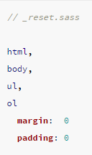
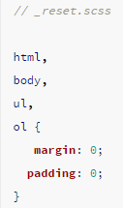
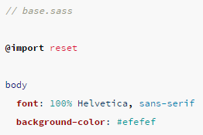
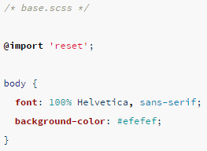
Import
Sass SYNTAX
SCSS SYNTAX
Notes:
When writing HTML you've probably noticed that it has a clear nested and visual hierarchy. CSS, on the other hand, doesn't.
Sass will let you nest your CSS selectors in a way that follows the same visual hierarchy of your HTML. Be aware that overly nested rules will result in over-qualified CSS that could prove hard to maintain and is generally considered bad practice.

Slide 18
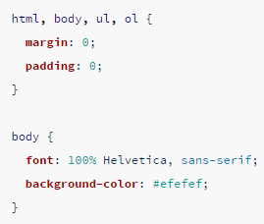
Import
.CSS
Notes:
Notice we're using @import 'reset'; in the base.scss file. When you import a file you don't need to include the file extension .scss. Sass is smart and will figure it out for you. When you generate the CSS you'll get:

Slide 19
Mixin
Notes:
Some things in CSS are a bit tedious to write, especially with CSS3 and the many vendor prefixes that exist. A mixin lets you make groups of CSS declarations that you want to reuse throughout your site. You can even pass in values to make your mixin more flexible. A good use of a mixin is for vendor prefixes. Here's an example for border-radius.

Slide 20
Mixin
A mixin lets you make groups of CSS declarations that you want to reuse throughout your site.
Notes:
Some things in CSS are a bit tedious to write, especially with CSS3 and the many vendor prefixes that exist. A mixin lets you make groups of CSS declarations that you want to reuse throughout your site. You can even pass in values to make your mixin more flexible. A good use of a mixin is for vendor prefixes. Here's an example for border-radius.

Slide 21
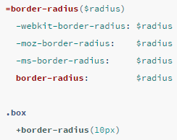
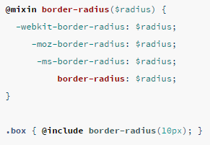
Mixin
Sass SYNTAX
SCSS SYNTAX

Slide 22
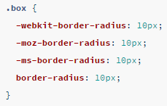
Mixin
.CSS
Notes:
To create a mixin you use the @mixin directive and give it a name. We've named our mixin border-radius. We're also using the variable $radius inside the parentheses so we can pass in a radius of whatever we want. After you create your mixin, you can then use it as a CSS declaration starting with @include followed by the name of the mixin. When your CSS is generated it'll look like this:

Slide 23
Extend/Inheritance
Notes:
Some things in CSS are a bit tedious to write, especially with CSS3 and the many vendor prefixes that exist. A mixin lets you make groups of CSS declarations that you want to reuse throughout your site. You can even pass in values to make your mixin more flexible. A good use of a mixin is for vendor prefixes. Here's an example for border-radius.

Slide 24
Extend/Inheritance
Using @extend lets you share a set of CSS properties from one selector to another.
Notes:
This is one of the most useful features of Sass. Using @extend lets you share a set of CSS properties from one selector to another. It helps keep your Sass very DRY. In our example we're going to create a simple series of messaging for errors, warnings and successes.

Slide 25
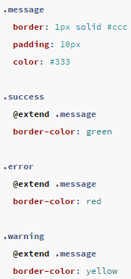
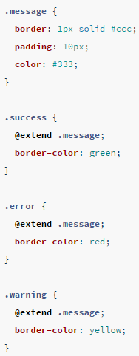
Extend/Inheritance
Sass SYNTAX
SCSS SYNTAX

Slide 26
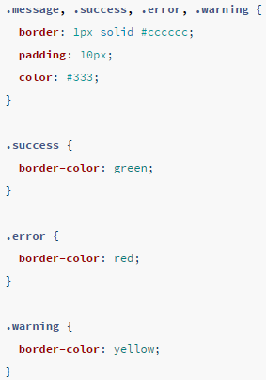
Extend/Inheritance
.CSS
Notes:
What the above code does is allow you to take the CSS properties in .message and apply them to .success, .error, & .warning. The magic happens with the generated CSS, and this helps you avoid having to write multiple class names on HTML elements. This is what it looks like:

Slide 27
Operators
Notes:
Doing math in your CSS is very helpful. Sass has a handful of standard math operators like +, -, *, /, and %. In our example we're going to do some simple math to calculate widths for an aside & article.

Slide 28
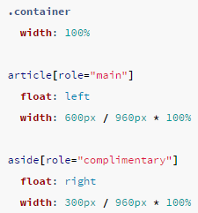
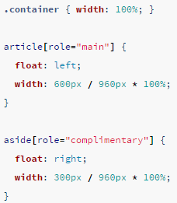
Extend/Inheritance
Sass SYNTAX
SCSS SYNTAX

Slide 29
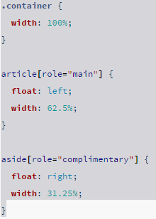
Operators
.CSS
Notes:
We've created a very simple fluid grid, based on 960px. Operations in Sass let us do something like take pixel values and convert them to percentages without much hassle. The generated CSS will look like:

Slide 30
Thanks
http://sass-lang.com/guide

Slide 31
Source
https://forwardhq.com/help/installing-ruby-windows
http://www.impressivewebs.com/sass-on-windows/
http://www.watchingthenet.com/how-to-navigate-through-folders-when-using-windows-command-prompt.html
Notes:
We've created a very simple fluid grid, based on 960px. Operations in Sass let us do something like take pixel values and convert them to percentages without much hassle. The generated CSS will look like:

